Slide 1
Chapter 2: Why is Software Architecture Important?

Slide 2
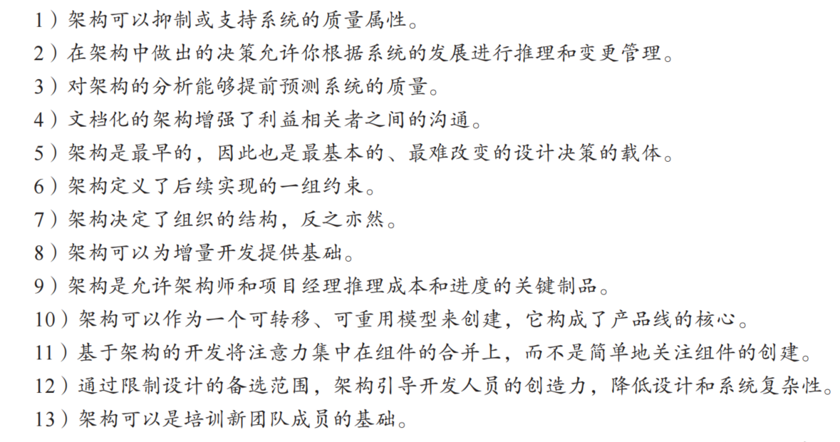

Slide 3
Who will use it

Slide 4
Inhibiting or Enabling a System’s Quality Attributes
Whether a system will be able to exhibit its desired (or required) quality attributes is substantially determined by its architecture.
  Performance
  Modifiability
  Security
  Scalability
  Reusability
Architect

Slide 5
例子
如果你的系统需要高性能，那么你需要关注管理元素基于时间的行为、它们对共享资源的使用以及元素间通信的频率和数量。
如果可修改性很重要，那么你需要关注将责任分配给元素，并限制这些元素的交互（耦合），以便系统的大多数变更只影响到这些元素中的少数。理想情况下，每个变更将只影响单个元素。如果你想让系统中的元素在其他系统中可重用，那么你需要限制元素间的耦合，这样当你提取一个元素时，它不会带出太多与当前环境相关的内容。
如果你的系统必须是高度防护（安全）的，那么你需要管理和保护组件间的通信，并控制哪 些组件可以访问哪些信息。你可能还需要在架构中引入专门的元素（例如授权机制） 来设置一个强大的“边界”以防止入侵。 还需要设计保障措施和恢复机制。
如果你认为性能的可伸缩性（可扩展性）对系统的成功非常重要，那么你需要将资源的使用本地 化，以便引入更高容量资源来替换，并且必须避免在资源假设或资源限制中进行硬 编码。

Slide 6
Reasoning About and Managing Change
About 80 percent of a typical software system’s total cost occurs after initial deployment
  accommodate new features
  adapt to new environments,
  fix bugs, and so forth.
Every architecture partitions possible changes into three categories
  A local change can be accomplished by modifying a single element.
  A nonlocal change requires multiple element modifications but leaves the underlying architectural approach intact.
  An architectural change affects the fundamental ways in which the elements interact with each other and will require changes all over the system.
Project manager

Slide 7
Reasoning About and Managing Change
Obviously, local changes are the most desirable
A good architecture is one in which the most common changes are local, and hence easy to make.
Project manager

Slide 8
Predicting System Qualities
When we examine an architecture we can confidently predict that the architecture will exhibit the associated qualities.
The earlier you can find a problem in your design, the cheaper, easier, and less disruptive it will be to fix.
Architect

Slide 9
Enhancing Communication Among Stakeholders
Stakeholders（客户、用户、项目经理、编码人员、测试人员等）
The architecture—or at least parts of it—is sufficiently abstract that most nontechnical people can understand it.
Most of the system’s stakeholders can use as a basis for creating mutual understanding, negotiating, forming consensus, and communicating with each other.
Each stakeholder of a software system is concerned with different characteristics of the system
  Users, client, manager, architect
All

Slide 10
例子
用户关心系统是否快速、可靠且在需要时可用。
客户（为系统付费的人）关心架构可以按计划和预算实施。
管理者关心架构（除了成本和进度方面之外）是否最大限度允许团队独立工作，以 有纪律和受控的方式进行交互。
架构师关心实现所有这些目标的策略。

Slide 11
Earliest Design Decisions
Software architecture is a manifestation of the earliest design decisions about a system.
These early decisions affect the system’s remaining development, its deployment, and its maintenance life.
What are these early design decisions?
  Will the system run on one processor or be distributed across multiple processors?
  Will the software be layered? If so, how many layers will there be? What will each one do?
  Will components communicate synchronously or asynchronously?
  What communication protocol will we choose?
  Will the system depend on specific features of the operating system or hardware?
  Will the information that flows through the system be encrypted or not?
Architect

Slide 12
早期设计决策
在作画时，甚至在开始作画之前， 艺术家就开始决定画布和材料—油彩、水彩还是蜡笔。一旦开始作画，就会相应做出其 他的决定：第一条线在哪里，它的宽度是多少，它的形状是什么？所有这些早期的决策都对最终画面的外观有很大的影响，并且每个决策都限制了接下来的许多决策。每一个单独的决策可能看起来都是无关紧要的，但早期的决策尤其具有不成比例的重要性，因为它们影响和限制了接下来的许多事情。
架构设计也是如此。架构设计也可以看作一系列的决策。就现在必须改变的额外决策而言，改变这些早期的决策将会引起连锁反应。是的，有时架构必须重构或重新设计，但 这不是一项轻松的任务，因为一片雪花就可能引发雪崩。

Slide 13
Defining Constraints on an Implementation*
An implementation exhibits an architecture if it conforms to the design decisions prescribed by the architecture.
  The implementation must be implemented as the set of prescribed elements
  These elements must interact with each other in the prescribed fashion
Each of these prescriptions is a constraint on the implementer.
Developer

Slide 14
Influencing the Organizational Structure*
Architecture prescribes the structure of the system being developed.
The architecture is typically used as the basis for the work-breakdown structure.
Project manager

Slide 15
例子
工作分解结构反过来决定了计划、调度和预算的单位，团队间的沟通渠道，配置控制和文件系统结构，集成和测试计划及程序，甚至项目的细节。当组建运维团队时，也将依据软件结构中的特定元素—数据库、业务规则、用户界面、设备驱动程序等进行相应分工。
建立工作分解结构的一个副作用是冻结了软件架构的某些方面。负责其中一个子系统的组可能会拒绝将其职责分到其他组。如果这些职责已经在合同中确认，改变职责可能会变得昂贵，甚至会引起诉讼。

Slide 16
Enabling Evolutionary Prototyping
Once an architecture has been defined, it can be prototyped as a skeletal system.
  A skeletal system is one in which at least some of the infrastructure is built before much of the system’s functionality has been created.
The fidelity of the system increases as prototype parts are replaced with complete versions of these parts.
This approach aids the development process because the system is executable early in the product’s life cycle.
This approach allows potential performance problems to be identified early in the product’s life cycle.
These benefits reduce the potential risk in the project.
Architect & Project manager

Slide 17
Improving Cost and Schedule Estimates
Architecture is used to help the project manager create cost and schedule estimates early in the project life cycle.
Top-down estimates are useful for setting goals and apportioning budgets.
Bottom-up understanding of the system’s pieces are typically more accurate than those that are based purely on top-down system knowledge.
The best cost and schedule estimates will typically emerge from a consensus between the top-down estimates (created by the architect and project manager) and the bottom-up estimates (created by the developers).
Project manager

Slide 18
Transferable, Reusable Model
Reuse of architectures provides tremendous benefits for systems with similar requirements.
  Not only can code be reused, but also can the requirements that led to the architecture in the first place
  When architectural decisions can be reused across multiple systems, all of the early-decision consequences are also transferred
Project manager

Slide 19
Using Independently Developed Components
Architecture-based development often focuses on components that are likely to have been developed separately, even independently
Commercial off-the-shelf components, open source software, publicly available apps, and networked services are example of interchangeable software components.
The payoff can be
  Decreased time to market
  Increased reliability
  Lower cost
  Flexibility
Developer

Slide 20
Basis for Training
The architecture can serve as the first introduction to the system for new project members.
Module views show someone the structure of a project
  Who does what, which teams are assigned to which parts of the system, and so forth.
Component-and-connector explains how the system is expected to work and accomplish its job.
All

Slide 21
Summary
An architecture will inhibit or enable a system’s driving quality attributes.
The decisions made in an architecture allow you to reason about and manage change as the system evolves.
The analysis of an architecture enables early prediction of a system’s qualities.
A documented architecture enhances communication among stakeholders.
The architecture is a carrier of the earliest and hence most fundamental, hardest-to-change design decisions.
An architecture defines a set of constraints on subsequent implementation.
The architecture dictates the structure of an organization, or vice versa.

Slide 22
Summary
An architecture can provide the basis for evolutionary prototyping.
An architecture allows the architect and project manager to reason about cost and schedule.
An architecture can be created as a transferable, reusable model that form the heart of a product line.
Architecture-based development focuses attention on the assembly of components, rather than simply on their creation.
By restricting design alternatives, architecture channels the creativity of developers, reducing design and system complexity.
An architecture can be the foundation for training a new team member.

